Slide 1
educating citizens, building communities

Slide 2
Service Learning and Engagement during the Pandemic
Dr. Marisol Morales
Vice President for Network Leadership
Campus Compact

Slide 3
Land Acknowledgement

Slide 4
Mission
Mission
Campus Compact advances the public purposes of colleges and universities by deepening their ability to improve community life and to educate students for civic and social responsibility.

Slide 5
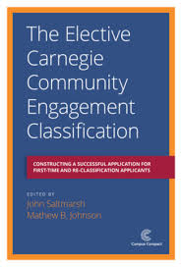
National Service Programs
VISTA
Americorps
Conferences & Professional Development
Campus Compact Programming
Awards & Recognitions
Publications
Webinars

Slide 6
Civic Action Plans
Credentialing Program
National Initiatives
Community Colleges for Democracy
Engaged Scholars Initiative
Newman Civic Fellows

Slide 7
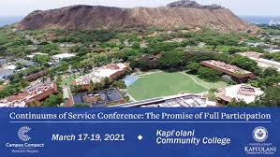
Podcast
Online Data Platform
Regional & National Resources
Blog
Regional Conferences
Affinity Groups
TRUCEN
The Research University Civic Engagement Network

Slide 8
Introductions

Slide 9
COVID Fatigue

Slide 10
Respond
Reconsider
The 5 R’s
Reimagine
Reconfirm
Reflect

Slide 11
Online Engagement with an Equity Lens
Student-centered learning community
Invite students to respond to a questions where they learn more about each other and you.
Assets-based Approach
Students and Faculty as co-learners
Expectations, Scaffolding, Frontend, Choices
Kathy Yep, PhD
Faculty, Claremont Colleges

Slide 12
What have do you know?
What do you want to know?
Notes:
10 minutes, report out popcorn style

Slide 13
Resources
Campus Compact Covid 19 Knowledge Hub
Inside Higher Ed article
Campus Compact Fusion Course
Ginsburg Center - University of Michigan
Ohio University Community Engagement Corona virus Resources
Campus Compact Covid webinar series

Slide 15
Contact Info
Marisol Morales
Vice President for Network Leadership
mmorales@compact.org
773-951-9981

